Slide 1
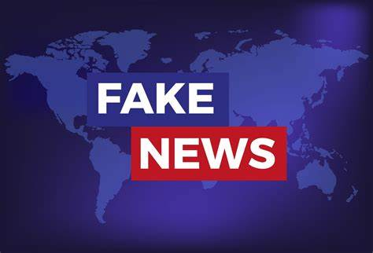
FAKE NEWS DETECTION PROJECT
Submitted By:
Lakshmi Rajendra Thute

Slide 2
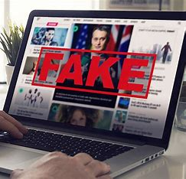
INTRODUCTION
Fake news's simple meaning is to incorporate information that leads people to the wrong path. Nowadays fake news spreading like water and people share this information without verifying it. This is often done to further or impose certain ideas and is often achieved with political agendas.
For media outlets, the ability to attract viewers to their websites is necessary to generate online advertising revenue. So, it is necessary to detect fake news.

Slide 3
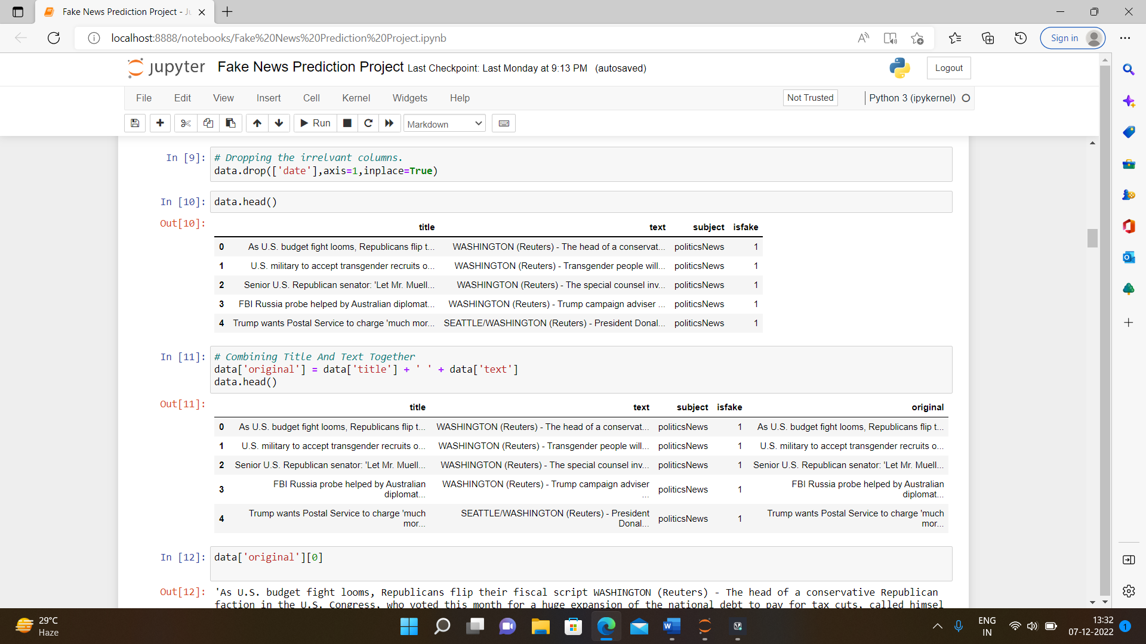
ANALYTICAL PROBLEM FRAMING
We got the dataset available from client, and we must build a model that is able to detect the fake news. We have data in two different sets, that are fake and true. We have to combine both of them together to build a mode, after combining the size of dataset becomes 44898. The dataset contains total 5 columns, they are title, text, subject, date, isfake.

Slide 4
DATA COLLECTION AND PREPROCESSING
• Mathematical/ Analytical Modelling of the Problem
Here I firstly read the dataset in jypyter notebook for cleaning the dataset I use pre-processing techniques, then did the Exploratory Data Analysis, then Encoding and lastly model Building and Evaluation.
• Data Sources and their formats
I got the dataset in CSV format, and I read the data in Jupyter Notebook using pandas data frame.
• Data Pre-processing Done
The dataset contains some irrelevant columns firstly we dropped that columns then we check the unique and duplicate values in the dataset, and removed them.

Slide 5
EXPLORATORY DATA ANALYSIS

Slide 6
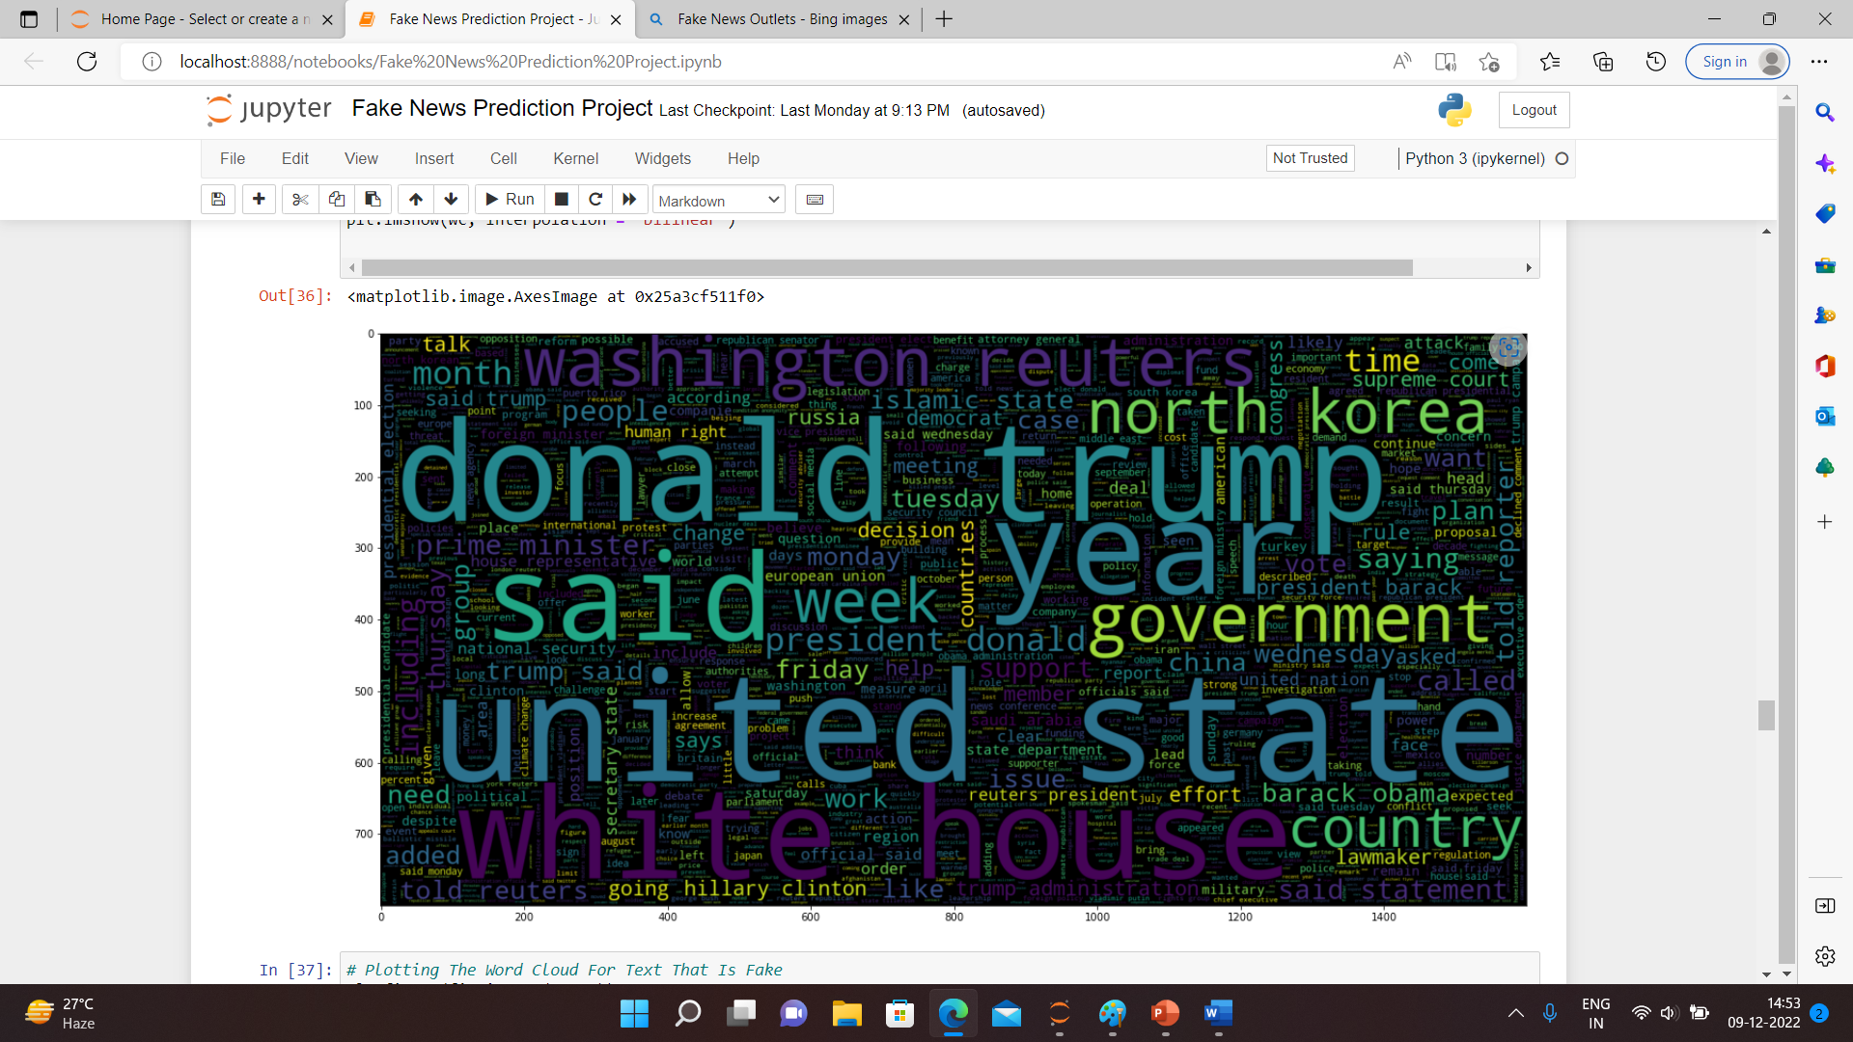
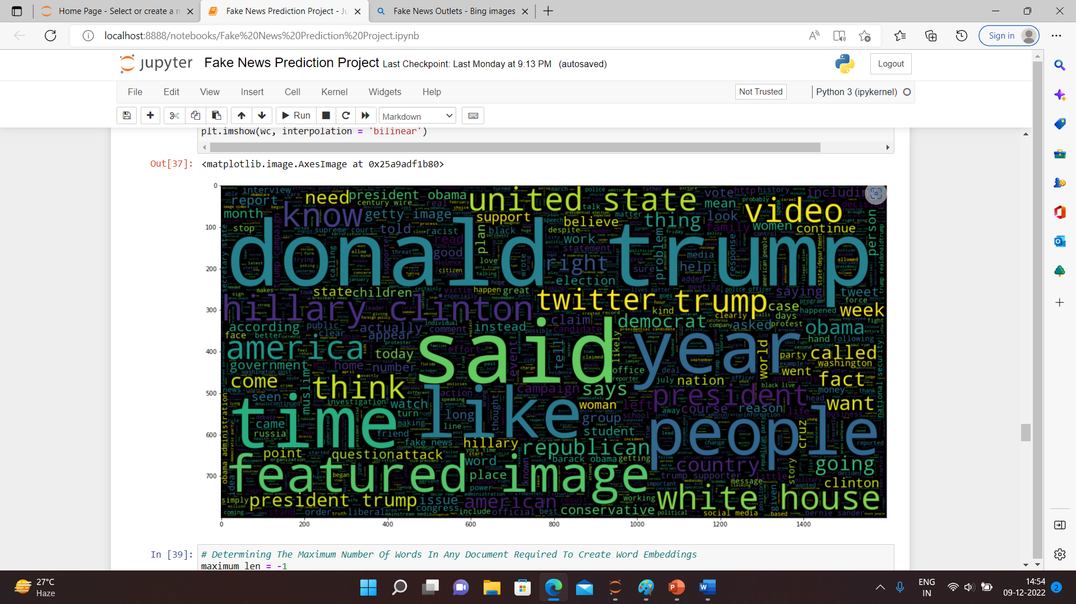

Slide 7
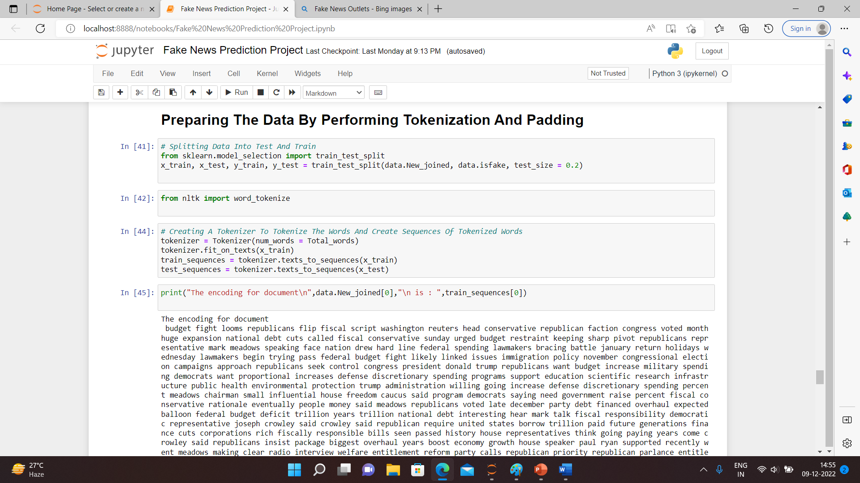

Slide 9
OBSERVATIONS
From the above bar graphs, we observe that the number of fake news are more as compared to true news.
The greatest number of news include political news, then world wide news and least no. of news are of middle-east and US-News.

Slide 10
INTERPRETATION OF RESULTS
After Pre-processing, Exploratory Data Analysis and model building, we observed that there is more no. of news that are inspired form true events that means true news

Slide 11
THANK YOU

